Slide 1
Item List
Jungwon, Zahra, Kunwoo
Prof. Gunho Sohn's Lab
York University
August 27 2019

Slide 2
Item List ^{(1/2)} (July 2 2019)
Type | Item Name | Battery | Components | Delivery State | Testing State
Drone | DJI M600 Set | O | M600 body / 1 RC / Batteries / RTK-GPS |  | Partially done
Gimbal | Ronin-MX | O | Ronin-MX Gimbal / 1 RC / Batteries
Drone | DJI M100 Set | O | M100 body / RC / Propellars / Batteries / A3 FC / Lightbridge |  | Partially done
Drone | DJI Mavic Air Set | O |  |  | Done
IMU | Spatial |  |  |  | Not done yet
UWB | TimeDomain | O | 5 UWB modules / 5 Batteries |  | Done
UWB | Pozyx |  |  |  | Not done yet
LiDAR | GeoSLAM | O | Scanner / Data logger / Dongle USB |  | Done
LiDAR | Velodyne Puck LITE |  |  |  | Not done yet
LiDAR | Velodyne Puck Hi-Res |  |  |  | Not done yet
LiDAR | Velodyne HDL-32E |  |  |  | Not done yet
Camera | Sony A7III | O |  |  | Not done yet
Camera | FLIR Duo R |  |  | Not delivered yet | Not done yet
Camera | ZED stereo |  |  |  | Not done yet
Camera | RealSense Depth |  |  |  | Not done yet
Computer | Intel NUC1 |  |  |  | Done
Computer | Intel NUC2 |  |  |  | Done
Computer | NVIDIA TX2 |  |  |  | Not done yet
Computer | Movidius

Slide 3
Item List ^{(2/2)} (July 2 2019)
Type | Item Name | Battery | Components | Delivery State | Testing State
Sub-device | Wifi router |  |  |  | Done
Sub-device | Laser distance |  |  |  | Done
Sub-device | Label maker |  |  |  | Done
 | Mini Prism |  |  |  | Done
Battery | Large1 | O |  |  | Done
Battery | Large2 | O |  |  | Done
Battery | Payload silver | O |  |  | Done
Solid | Tripod |  |  |  | Done
Solid | Chair |  |  |  | Done
Solid | Table |  |  |  | Done

Slide 4
DJI M600 Set

Slide 5
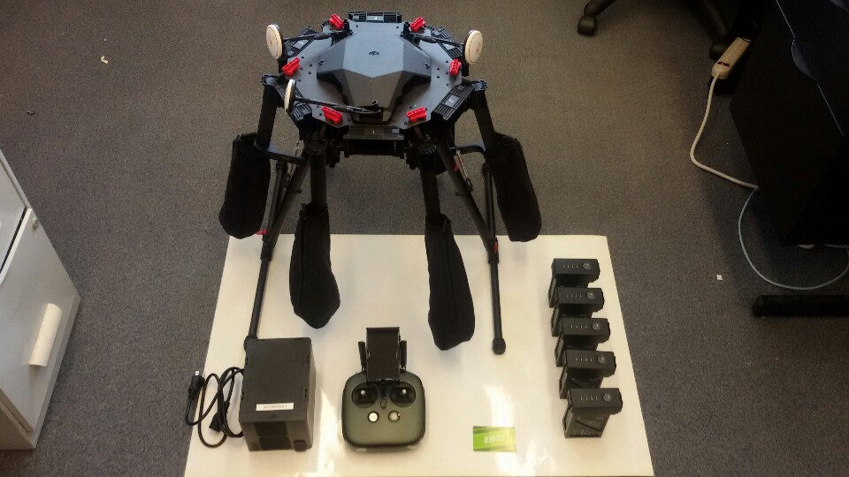
DJI M600 Set (1/1)
*We had total six TB47S batteries, and one TB47S battery is not included in the picture.
*RTK-GPS is not included in the picture.
*DJI battery charger (placed at the right-bottom of this picture) is one of total three chargers for DJI M100.

Slide 6
DJI Ronin-MX Gimbal Set

Slide 7
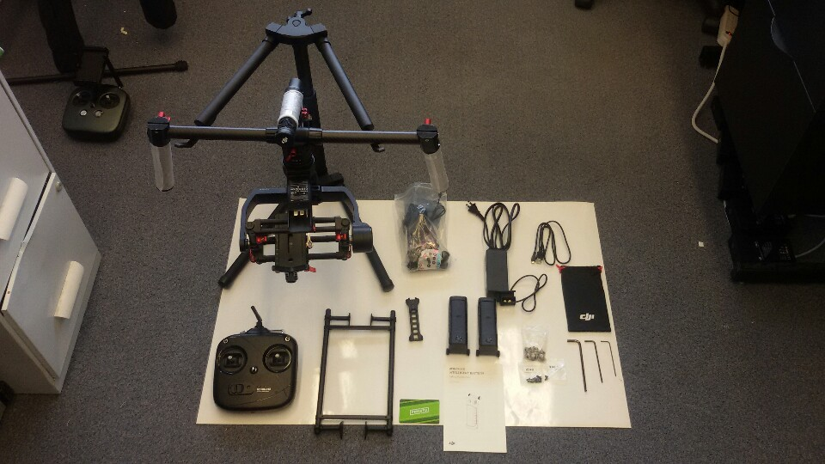
DJI Ronin-MX Gimbal Set (1/1)

Slide 8
DJI M100 Set

Slide 9
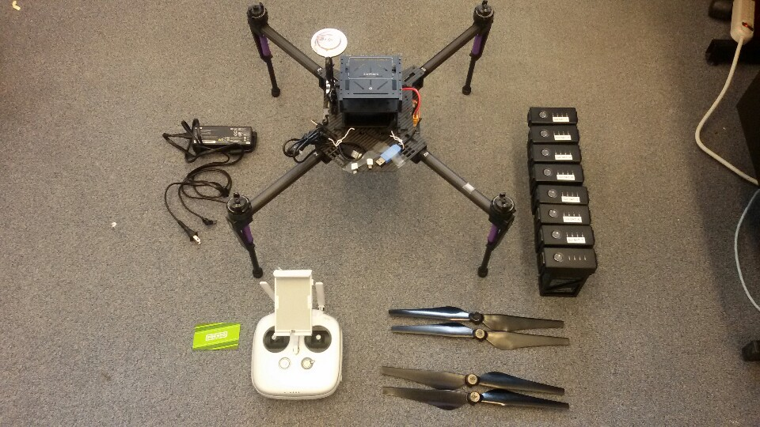
DJI M100 Set (1/4)

Slide 10
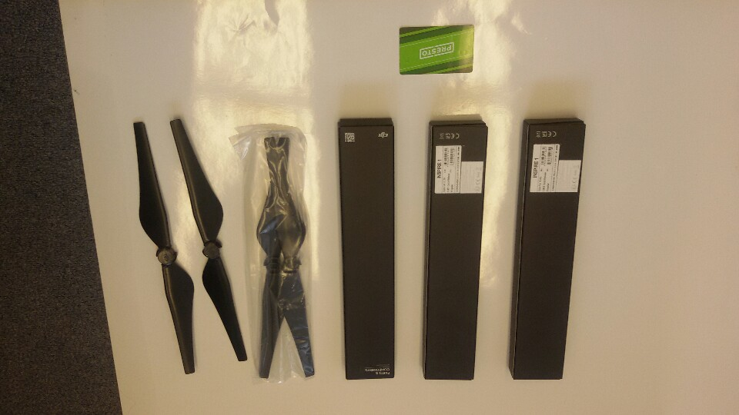
DJI M100 Set (2/4)

Slide 11
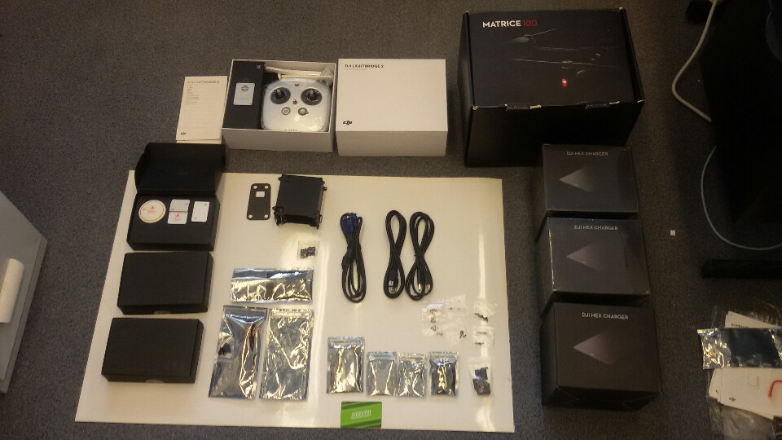
DJI M100 Set (3/4)

Slide 12
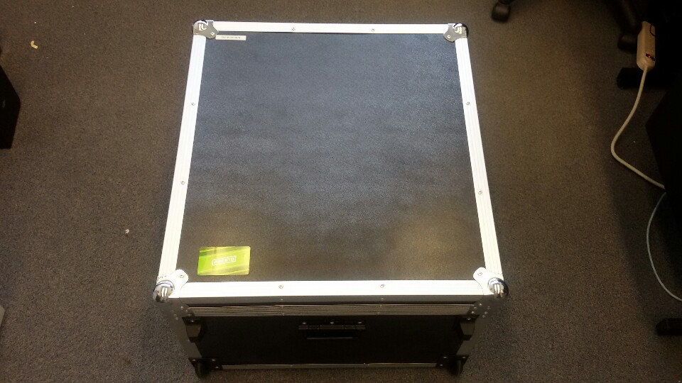
DJI M100 Set (4/4)

Slide 13
DJI Mavic Air Set

Slide 14
DJI Mavic Air Set (1/)
To be added...

Slide 15
TimeDomain UWB P440

Slide 16
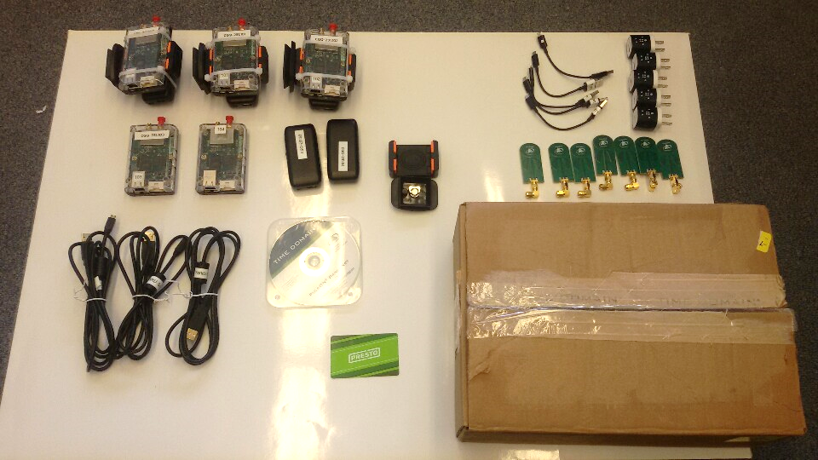
TimeDomain UWB P440 (1/1)

Slide 17
GeoSLAM

Slide 18
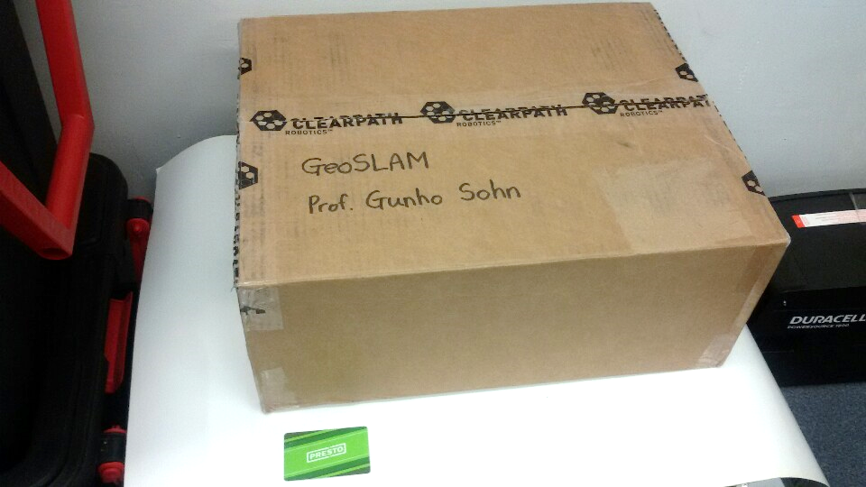
GeoSLAM (1/4)

Slide 19
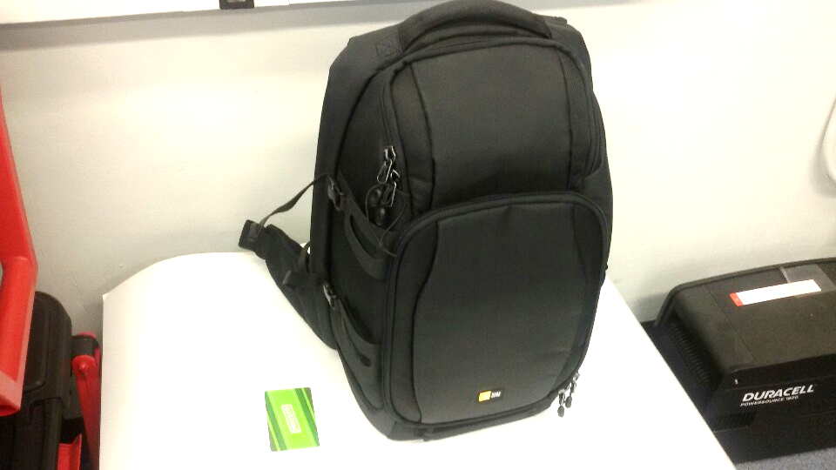
GeoSLAM (2/4)

Slide 20
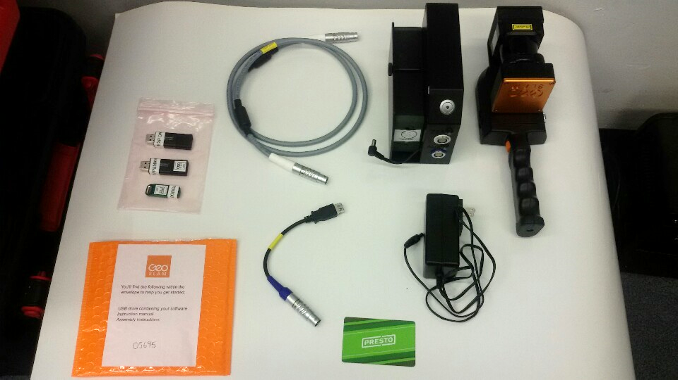
GeoSLAM (3/4)

Slide 21
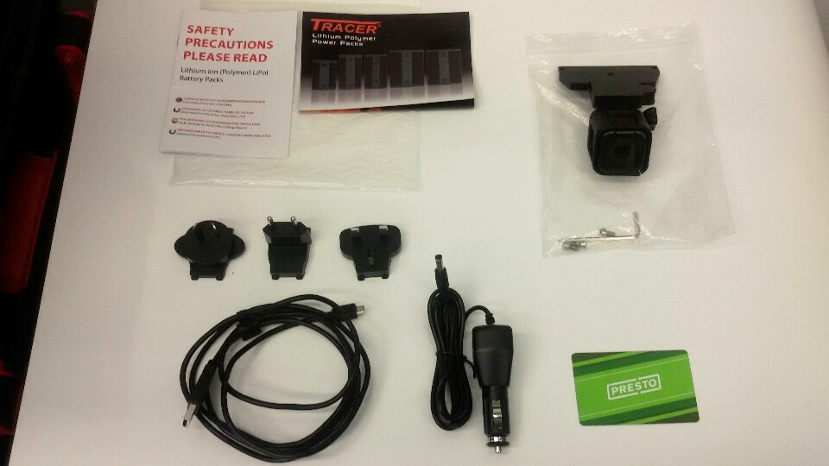
GeoSLAM (4/4)

Slide 22
Velodyne Puck LITE

Slide 23
Velodyne Puck LITE (1/)
To be added...

Slide 24
Velodyne Puck Hi-Res

Slide 25
Velodyne Puck Hi-Res (1/)
To be added...

Slide 26
Velodyne HDL-32E

Slide 27
Velodyne HDL-32E (1/)
To be added...

Slide 28
Intel RealSense D435
It was borrowed from Prof. Mozhdeh.

Slide 29
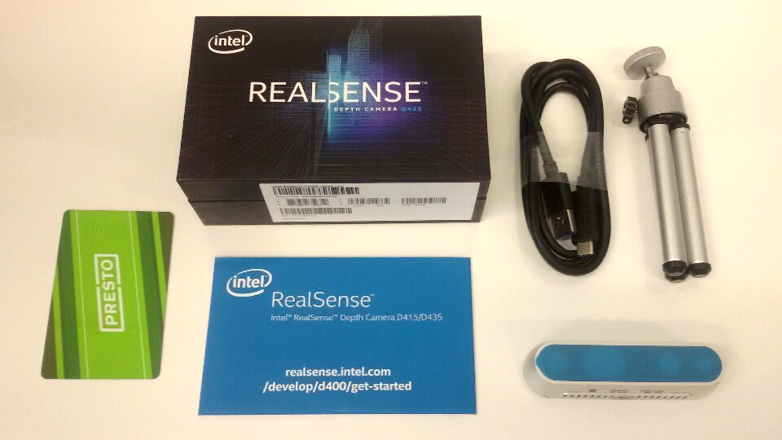
Intel RealSense D435 (1/1)

Slide 30
Intel NUC1

Slide 31
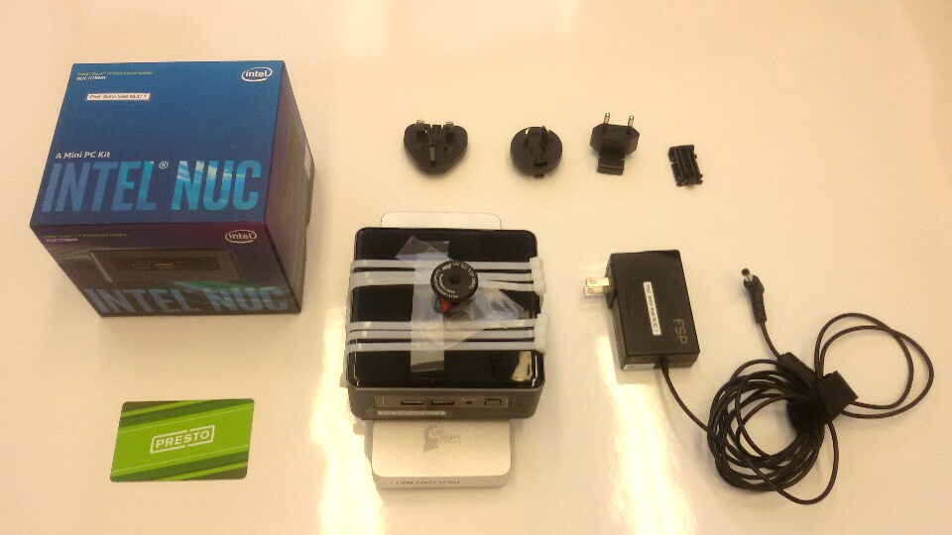
Intel NUC1 (1/1)

Slide 32
Intel NUC2

Slide 33
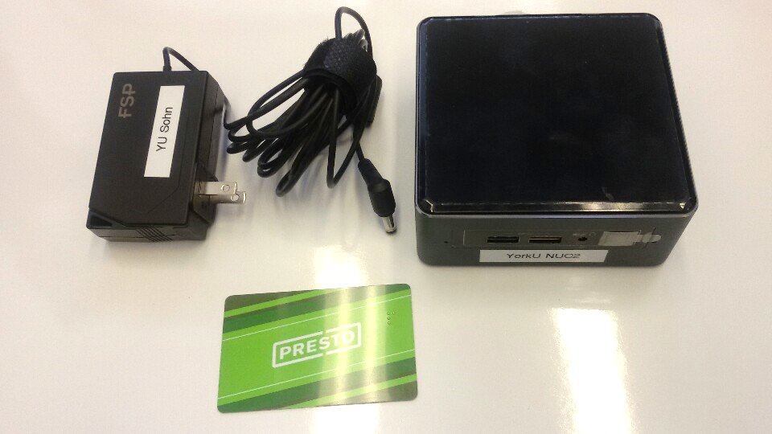
Intel NUC2 (1/1)

Slide 34
NVIDIA Jetson TX2

Slide 35
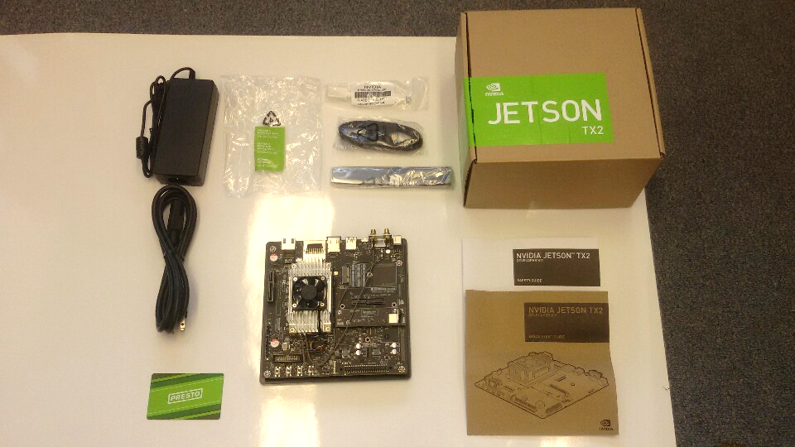
NVIDIA Jetson TX2 (1/1)

Slide 36
Movidius Neural Compute Stick

Slide 37
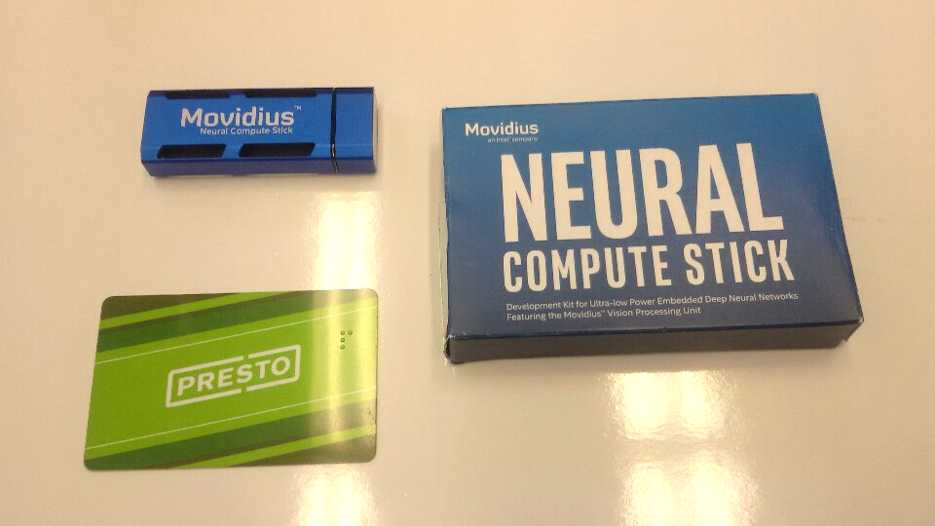
Movidius Neural Compute Stick (1/1)

Slide 38
Wifi Router

Slide 39
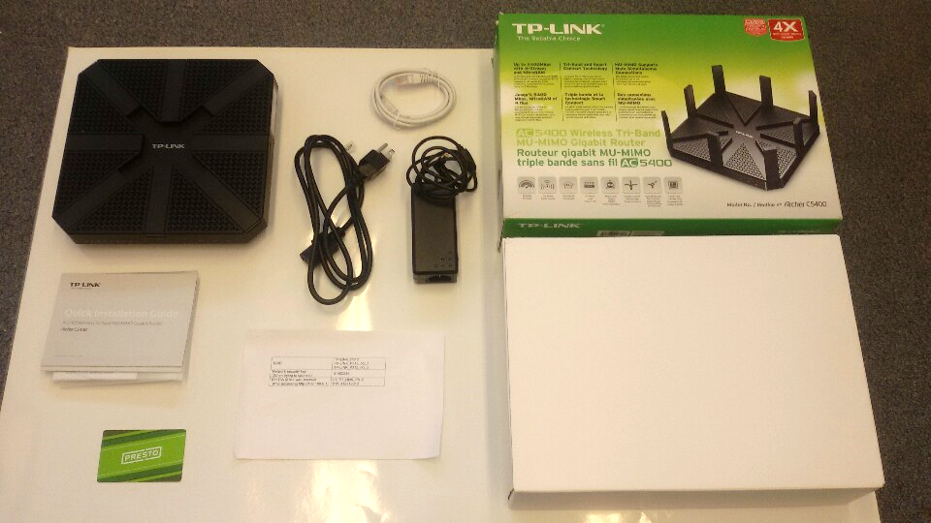
Wifi Router (1/1)

Slide 40
Laser Distance Measurer

Slide 41
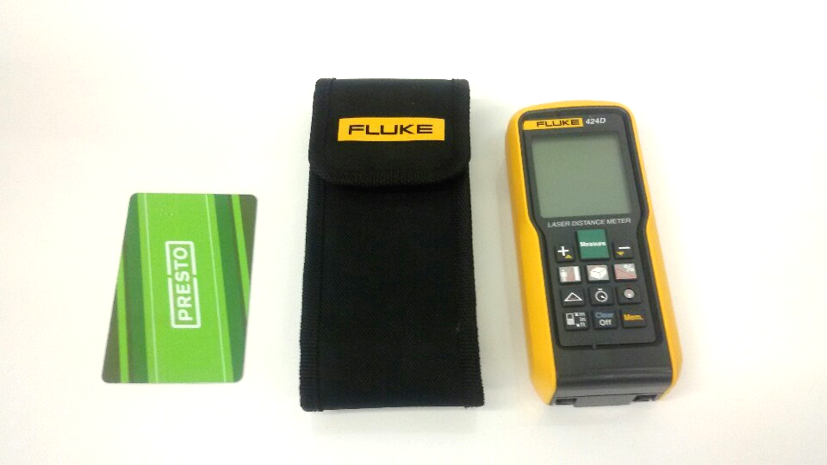
Laser Distance Measurer (1/1)

Slide 42
Label Maker

Slide 43
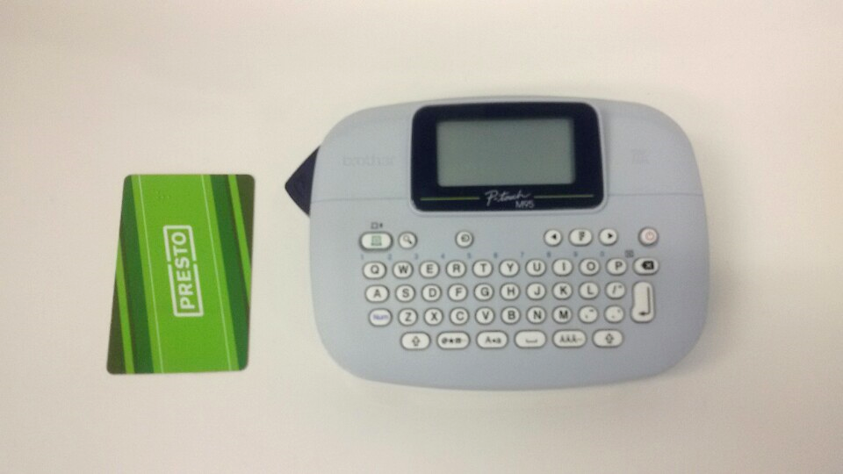
Label Maker (1/1)

Slide 44
Mini Prism

Slide 45
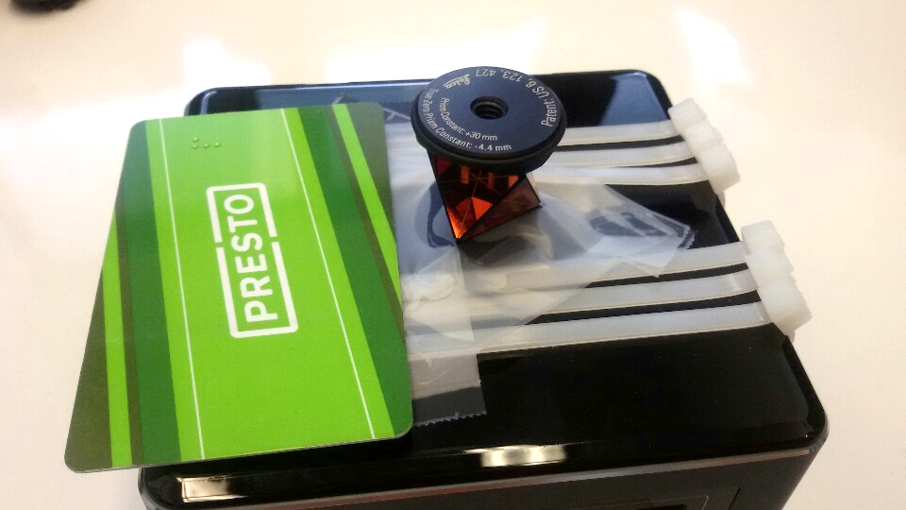
Mini Prism (1/1)

Slide 46
Battery Large1

Slide 47
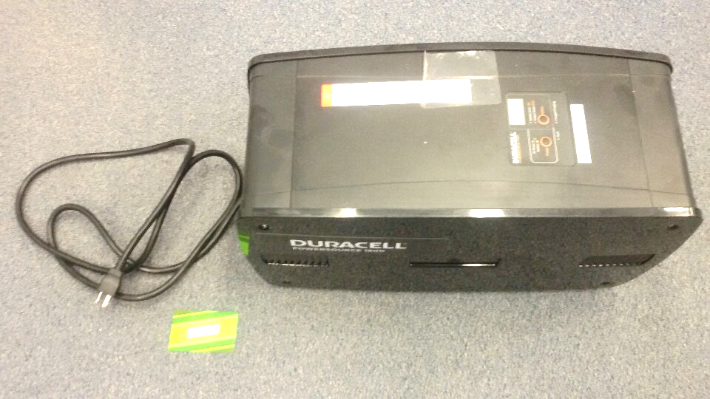
Battery Large1 (1/1)

Slide 48
Battery Large2

Slide 49
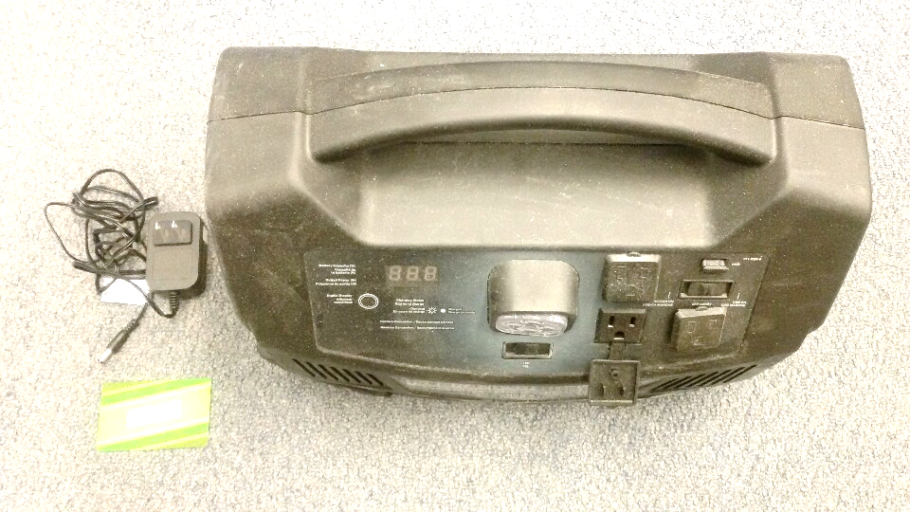
Battery Large2 (1/1)

Slide 50
Battery Payload Silver

Slide 51
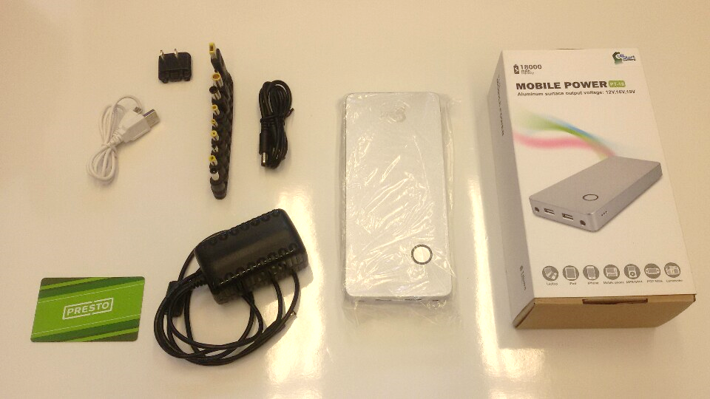
Battery Payload Silver (1/4)

Slide 52
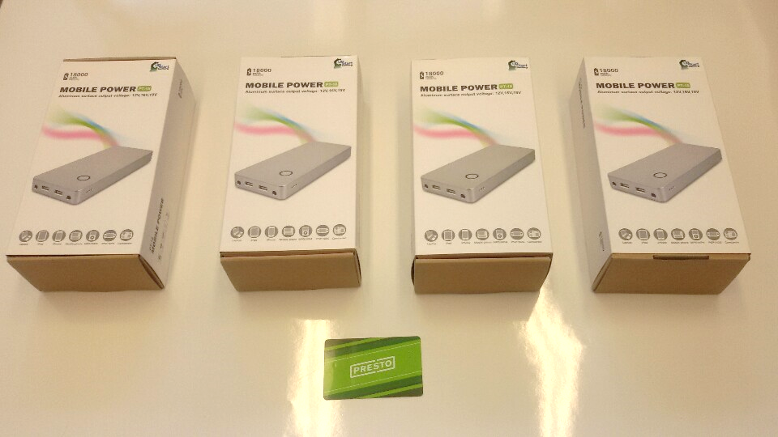
Battery Payload Silver (2/4)

Slide 53
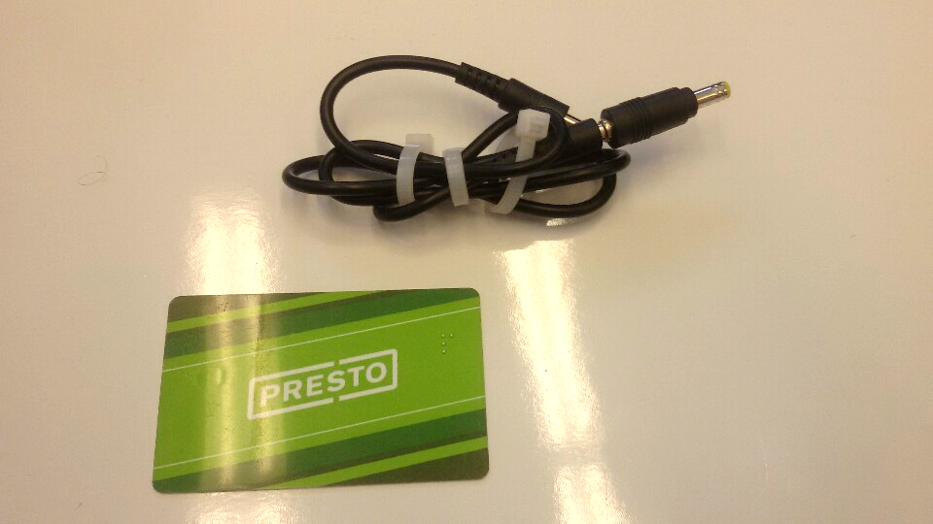
Battery Payload Silver (3/4)

Slide 54
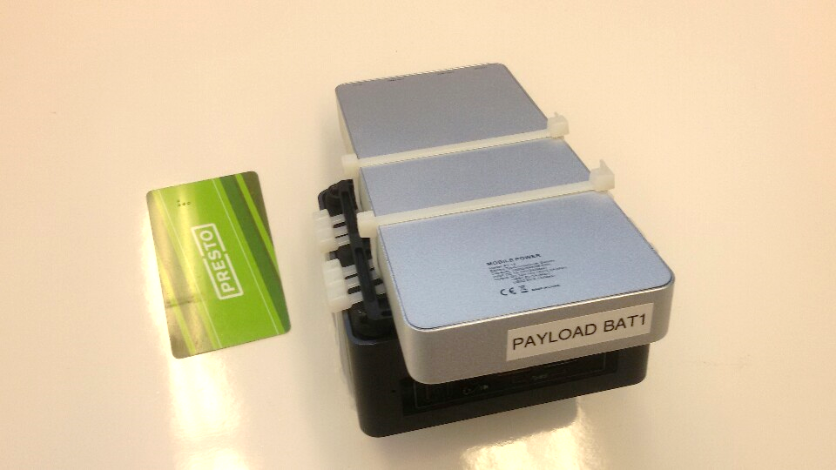
Battery Payload Silver (4/4)

Slide 55
Tripod

Slide 56
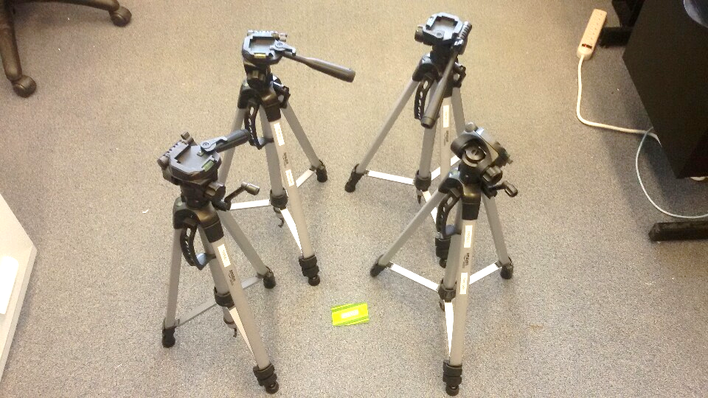
Tripod (1/1)

Slide 57
Chairs

Slide 58
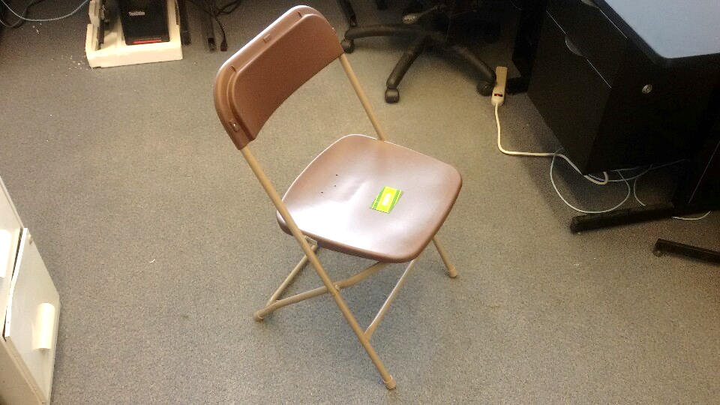
Chairs (1/1)

Slide 59
Table

Slide 60
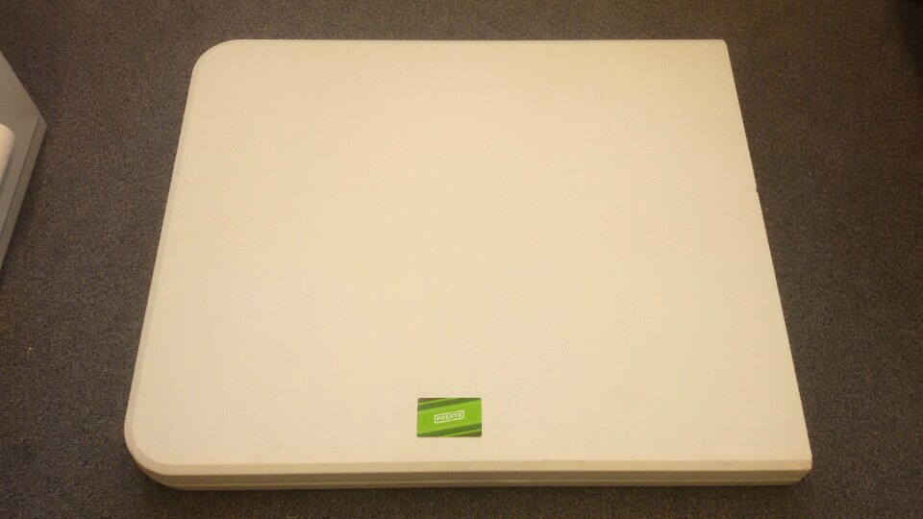
Table (1/1)

Slide 61
Etc

Slide 62
Purchased at Aug 26 2019
Purchased at Henry's
1 GoPro7
1 Warranty for GoPro7
2 64GB SD card
Purchased at Canadian Tire
1 electricity generator
1 motor oil
1 cart
3 small tools

Slide 63
To be Purchased
DJI M600 Batteries
106 - 7777 Weston Rd, Vaughan, ON L4L 0G9
Hours: Closes 6 p.m.
Phone: (905) 605-8030
Laptop
Humatics UWB
~ Sept 20 2019 (See the next page)

Slide 64
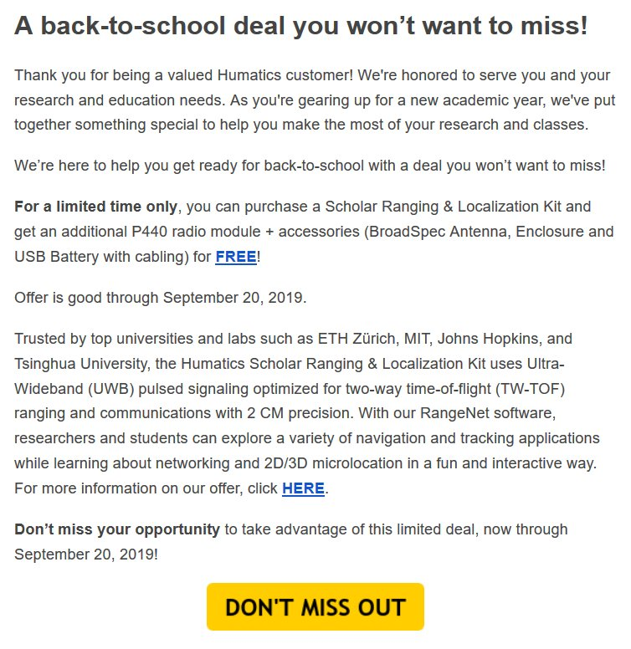
Humatics UWB Offer
https://www.humatics.com/products/back-to-school-offer-for-scholar-ranging-localization/?utm_campaign=Back-to-School%20Scholar%202019&utm_source=hs_email&utm_medium=email&utm_content=75408280&_hsenc=p2ANqtz-_ID8gOsXWcgV-w4hNzPm9e4yg9LwQLtITVdN2sSq3GY0Sa9vbIQT2Um3DKEdxP1cPF_3WyKBL5s3fKo54qgHd0RC7W-w&_hsmi=75408757

